Slide 1
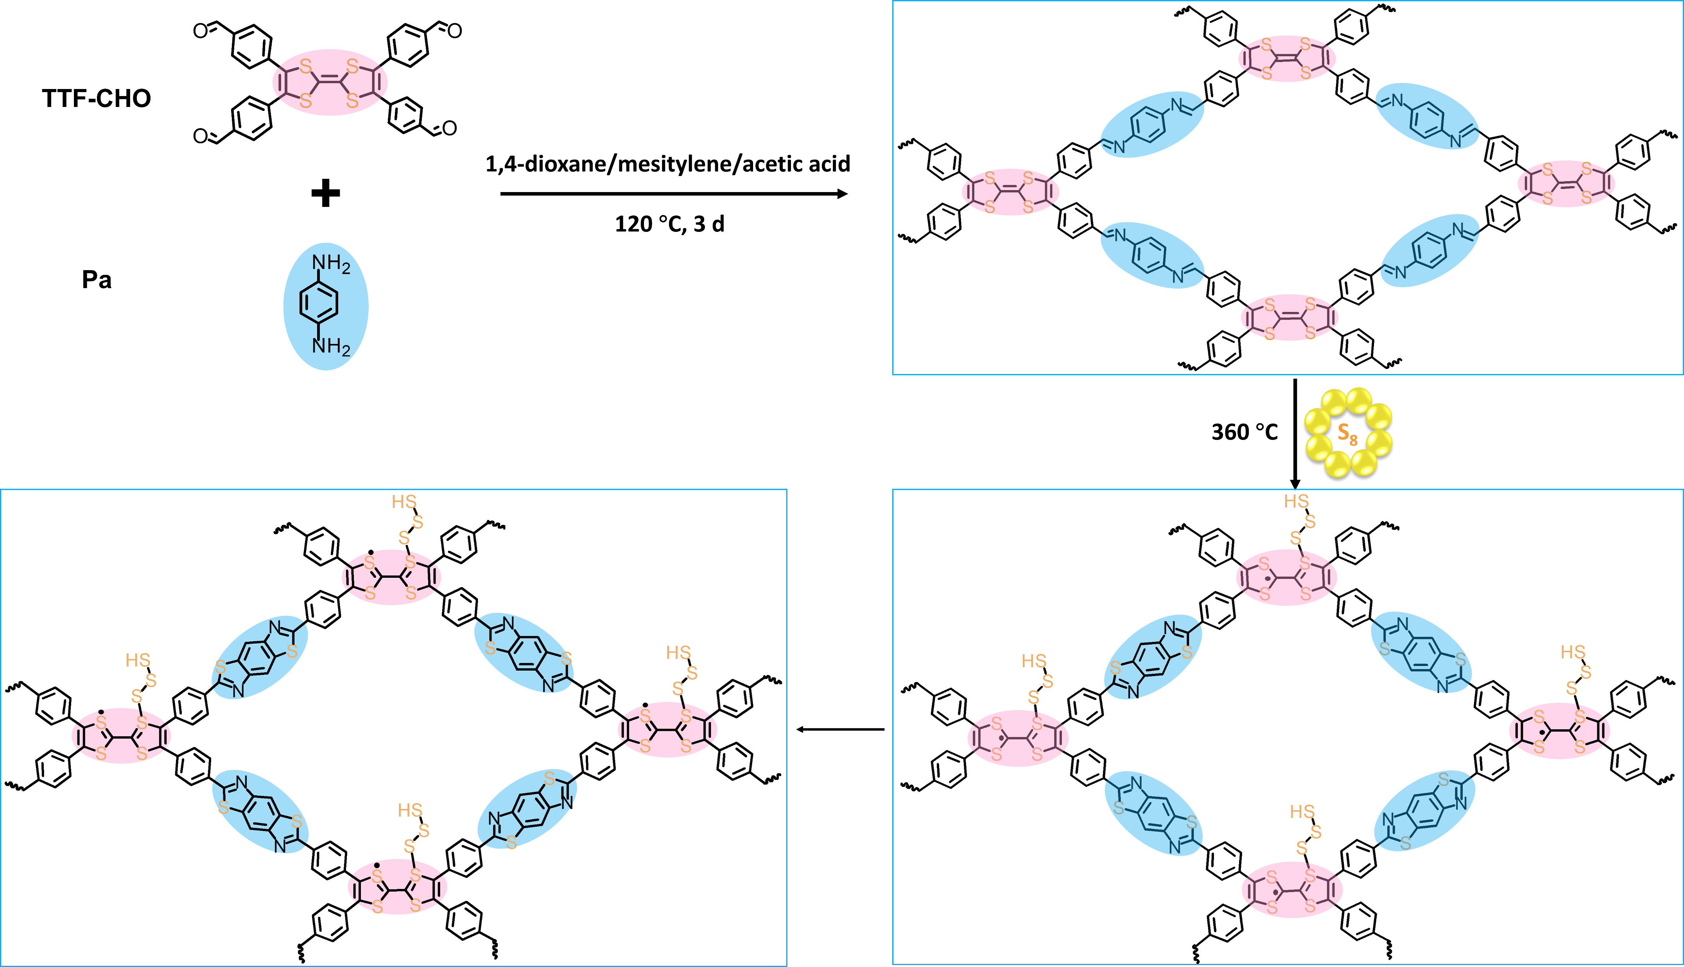
Structure of COF and ssNMR (experimental and simulated)
Simulated NMR spectra

Slide 2
Structure of SCOF and ssNMR (experimental and simulated)
1
2
We simulate the NMR result of the sulfurized structure. When the sulfur Chain is linked to the carbon, there should be characteristic peaks in NMR spectra around 60-80 ppm (corresponding to the C-S bond). However, in our ssNMR result, these is no peaks in this region.
We simulate the structure of 1 and 2, this simulated result match well with the experimental one. In this case, the sulfur chain is attached in thd sulfur sites.
But it is not clear that where the single electron located is, in cardon (structure 2) or in sulfur (structure 1) or both.
Simulated NMR spectra

Slide 3
Raman spectra of COF and SCOF
1225 cm⁻¹ C=S bond
From our Raman spectra, we can see the appearance of C=S bond and S-S in SCOF, which also support the structure 1 or 2.
521 cm⁻¹ S-S bond

